Slide 1
Introduce the project in a manner that can be comprehended by an audience with limited expertise in the topic area.
Project background and context
Clearly state the purpose
Clearly explain the deliverables
Justify your claims with various forms of evidence and argument
Give a brief overview on the approach used (this need not be too detailed, but enough to convince the audience that you had a well-considered plan for designing and executing the project)
Clearly describe YOUR contributions from the project
Discuss your findings/outcomes: what artefacts did you create or what insights did you gain?
Discuss the implications of your findings/outcomes (the ‘so what?’ of this work: who can use these findings/outcomes, and how might they use them?)

Slide 2
Project Outline
1. Complexity of Data + Project Background (top, worse driver) + Project Problem + Motivation
2. Project Purposes + In-Scope Data (5 States mainly)
3. Methodologies for Project Plan and Execution
4. Outcomes: Driving Demographic Comparison
Traffic Violation Comparison
5. Significance of Outcomes
2. Project Deliverables: Data Descriptive Analysis Report

Slide 3



Exploration of the Stanford Open Policing Dataset Across United States A Research Project IFN702 Project
Records for patrol stops across the country over years (2004-2016)
Raw data are gathered by law enforcement agencies
Data are standardized and open freely in June 2017 by a project team consists 7 researchers from Stanford University.
Student: Linni QIN (n9632981)
Supervisor: Dr Dimitri Perrin
Pictures from https://media.licdn.com/mpr/mpr/AAEAAQAAAAAAAAc7AAAAJGU4NzE1MjFmLTI3ZWMtNDc1Ni05ZTlkLWI4YmY3MmU1NWZjZA.jpg

Slide 4
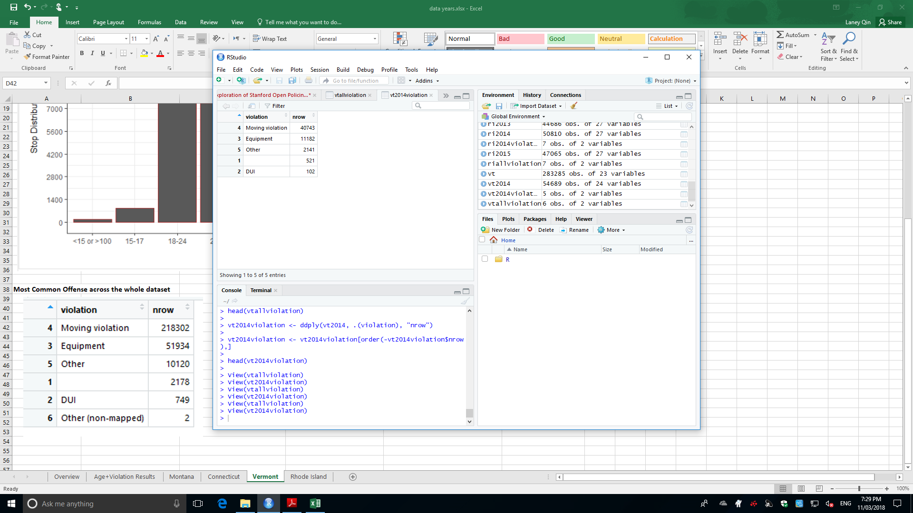
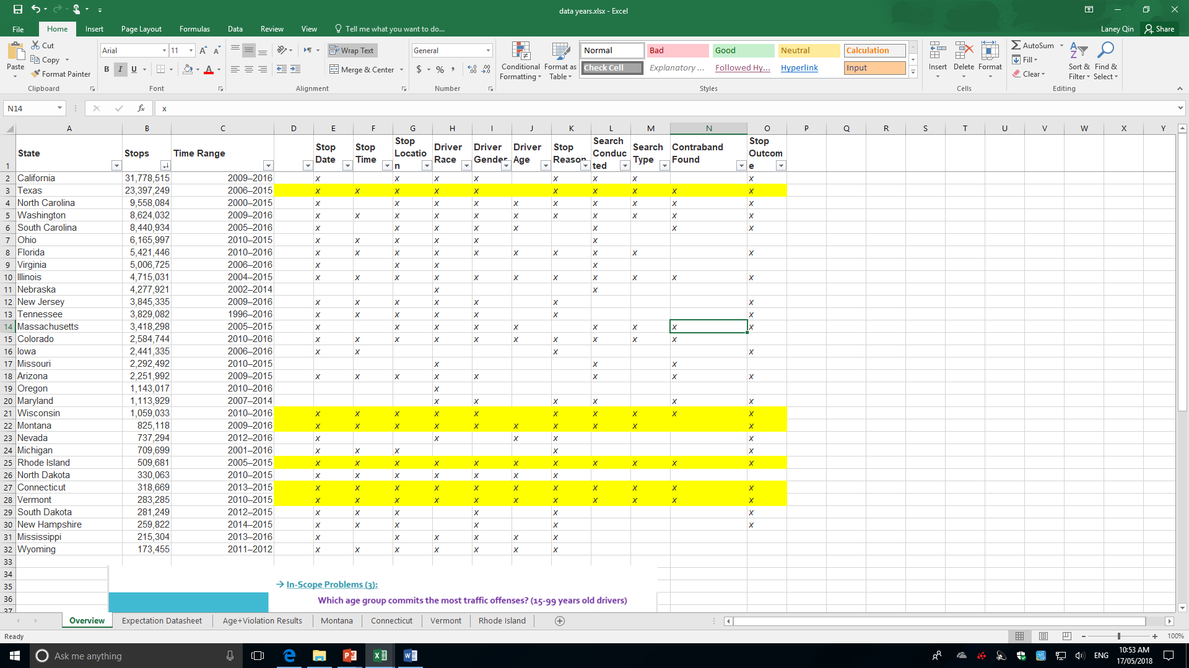
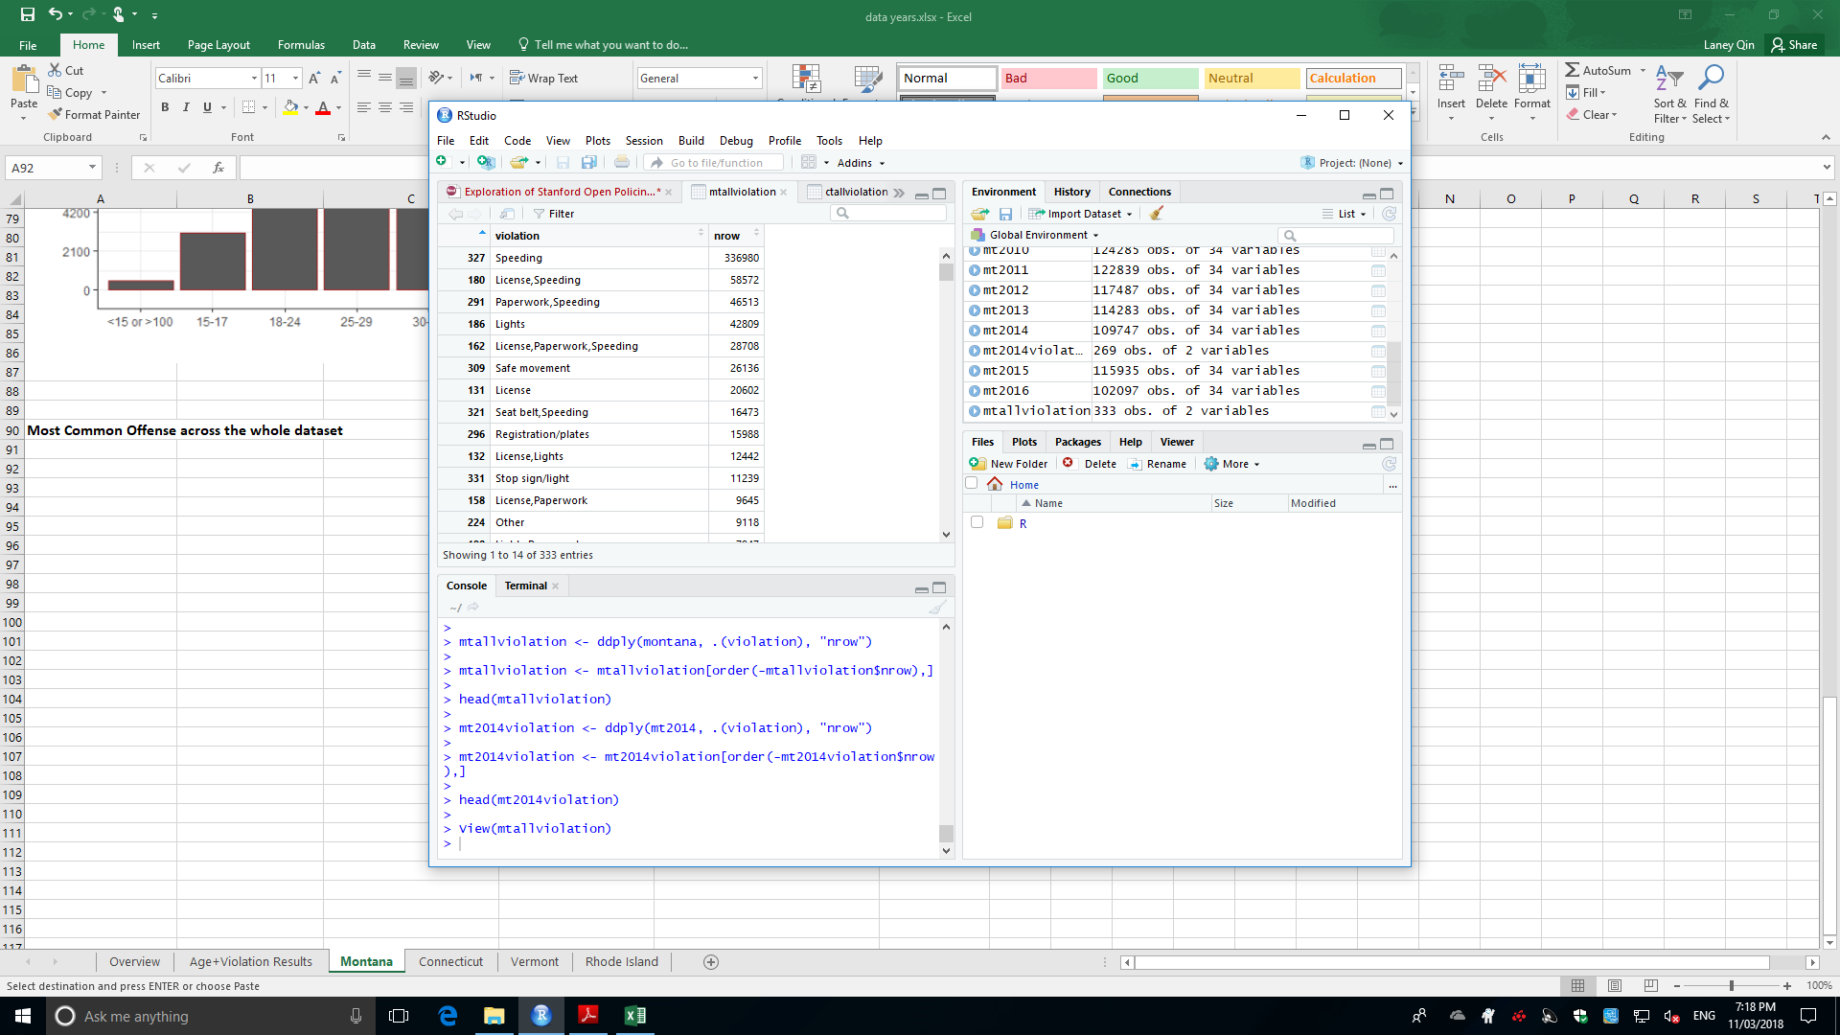
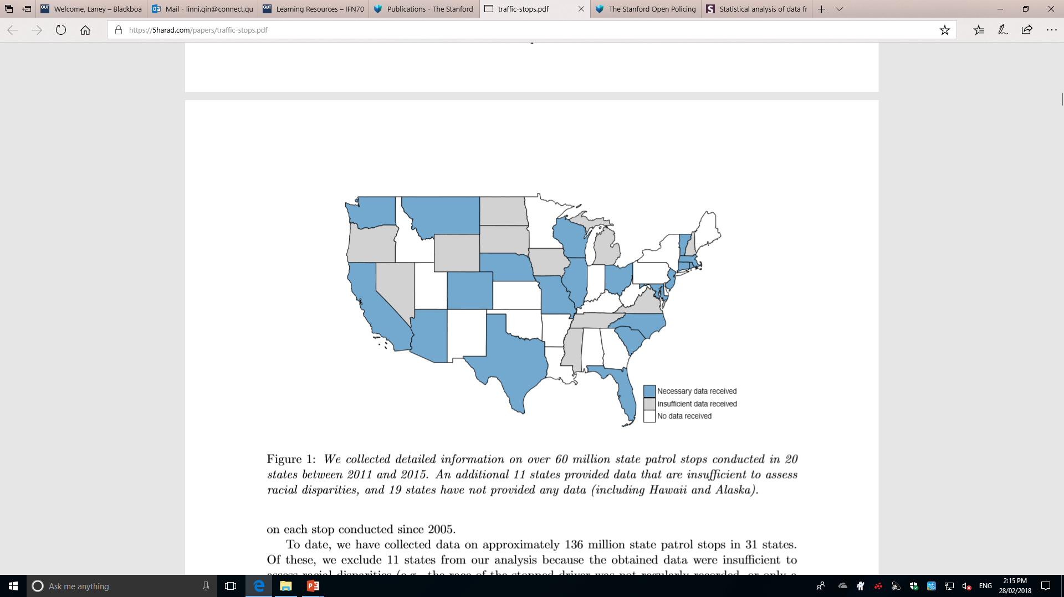
Complexity of Data
31 states have collected data (19 states no e-data)
> 50,000 patrol stops / day, data size differentiate stately
Log formats differentiate stately (e.g. attributes 54, 38, 23, violation)
Time ranging from 2004 to 2016 (full 12 months, parts of a year)
State | Stops | Time Range | 2009 | 2010 | 2011 | 2012 | 2013 | 2014 | 2015 | 2016
Washington | 8,624,032 | 2009–2016 | Jan - Dec | Jan - Dec | Jan - Dec | Jan - Dec | Jan - Dec | Jan - Dec | Jan - Dec | Jan - Mar
Colorado | 2,584,744 | 2010–2016 | x | Jan - Dec | Jan - Dec | Jan - Dec | Jan - Dec | Jan - Dec | Jan - Dec | 1-3,6,10,12
Nevada | 737,294 | 2012–2016 | x | x | x | Feb, Jul - Dec | Jan - Dec | Jan - Dec | Jan - Dec | Jan - May
North Dakota | 330,063 | 2010–2015 | x | Jan - Dec | Jan - Dec | Jan - Dec | Jan - Dec | Jan - Dec | Jan - June | x
Wyoming | 173,455 | 2011–2012 | x | x | Jan - Dec | Jan - Dec | x | x | x | x
What I need to do:
Aiming at ideal features and states
Determining techniques to measure those complexity data then extracting the valuable one
Identifying any relationships among features (Classification Model)
Reflecting the outcomes
Pictures from https://openpolicing.stanford.edu/

Slide 5
Project Purpose
In general, this project is to investigate the distribution and the trends of offending behaviours among different aged drivers in the United Sates
→ Main objectives of this project:
1. To claim an effective method to aggregate the driving violation
2. To compute the weight of traffic violation and offenders (by state-level, year-level)
3. To examine the correlation between the driver ages and traffic citation;
Top Causes of Car Accidents in US
Speeding
DUI (Driving under the influence of alcohol or drug)
Distracted Driving (Cell Phone or other digital device use)
Which age group of drivers are responsible for those violation mainly?
Younger Adult Driver (20-30)??? New Driver, Risky
Older Adult Driver (30+)??? Age affected driving errors
https://thomasjhenrylaw.com/blog/auto-accidents/top-causes-car-accidents/

Slide 6
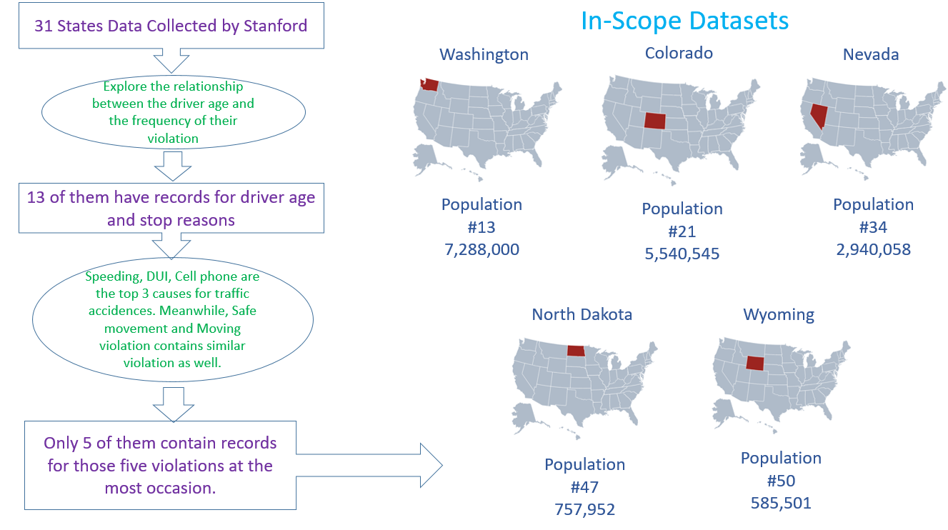
In-Scope Datasets

Slide 7
Project Deliverables
→ A Descriptive Analysis Report
Techniques:
1) Methods to aggregate complex data and extract the valuable data
2) Methods to compute and compare the weight of traffic violation and offenders with levels of state and time
Analysis: 1) Demographic analysis based on resident population and the driver population
2) Correlations between traffic violation and driver age
3) Trends of driving error activities within each targeted states
4) Reason detection for certain outstanding data

Slide 8
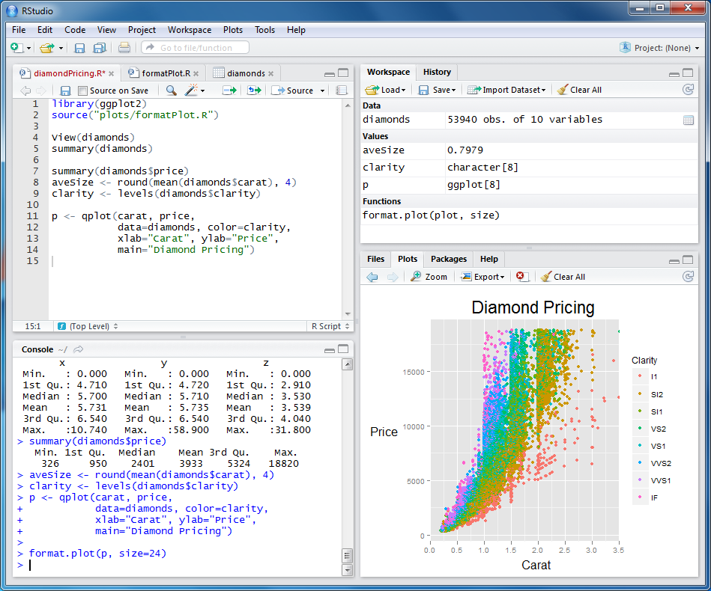
Methodologies for Project Plan and Execution
Project Methodologies:
Project Management Approach: Scrum Cynefin: Complex products and complex environment
Scrum Advantages (5):
Transparent plan and visible progress will make the communication effective between supervisor and me.
“To do”, “done” “undo” will enable me to control the progress on the right track.
Sprint retrospect will allow me to adjust progress as an increment.
It will enable the project to be completed on time.
It will help to reduce the risk of submitting failure outcomes.
Programming Tools: R and RStudio
Phase One Data Preparation | Phase Two Data Analysis | Phase Three Results Reflection | Phase Four Results Dissemination
Step 1: Defining problem Step 2: Identifying ideal datasets to answer analysis problems Step 3: Acquiring data Step 4: Cleaning data | Step 5: Exploring data Step 6: Modelling data and Statistical analysis | Step 7: Interpreting results | Step8: Communicating and distributing results

Slide 9
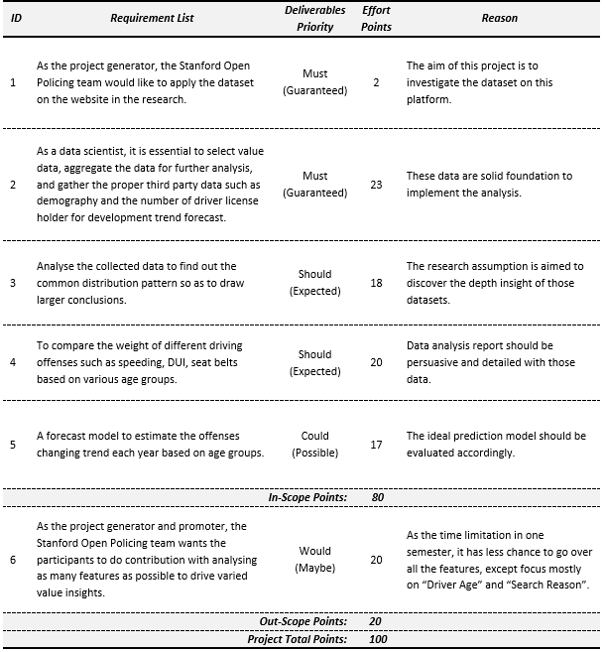
MoSCow Prioritised Scope List

Slide 10
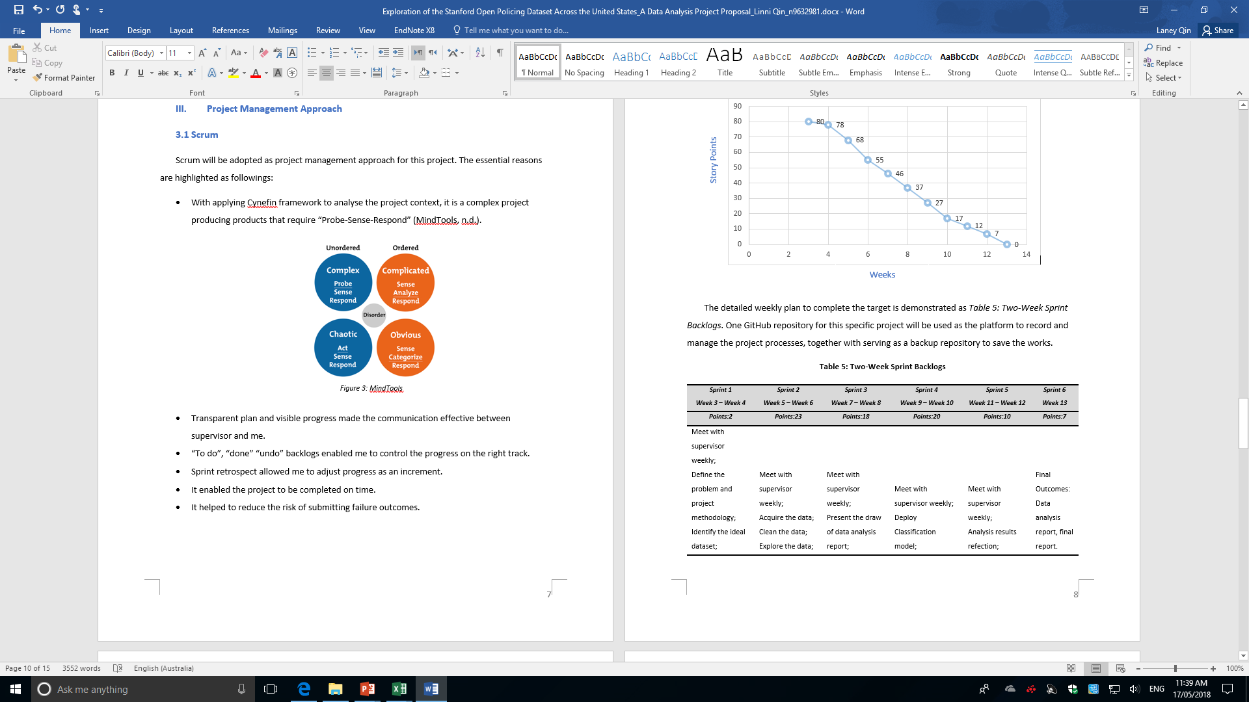
Scrum and 3rd party Tool to Manage Project
Phase 3:
Result Reflection
Phase 4:
Result
Dissemination
Phase 1:Data Preparation
Phase 2: Data Analysis

Slide 11
Outcomes Overview
Demographic Overview
By Population Size Order
State | Year | Population | Change% | Licensed Driver | Change% | Violation | Chang%
Washington | 2009 | 6,667,426 |  | 5,026,521 |  | 1,246,132
Washington | 2010 | 6,741,386 | 1.11% | 5,106,367 | 1.59% | 1,207,779 | -3.08%
Washington | 2011 | 6,819,155 | 1.15% | 5,178,789 | 1.42% | 1,262,424 | 4.52%
Washington | 2012 | 6,890,899 | 1.05% | 5,227,889 | 0.95% | 1,219,979 | -3.36%
Washington | 2013 | 6,963,410 | 1.05% | 5,301,630 | 1.41% | 1,210,336 | -0.79%
Washington | 2014 | 7,046,931 | 1.20% | 5,401,139 | 1.88% | 1,167,353 | -3.55%
Washington | 2015 | 7,152,818 | 1.50% | 5,516,314 | 2.13% | 1,228,778 | 5.26%
Colorado | 2010 | 5,048,029 |  | 3,779,273 |  | 481,434
Colorado | 2011 | 5,116,411 | 1.35% | 3,669,816 | -2.90% | 470,556 | -2.26%
Colorado | 2012 | 5,186,330 | 1.37% | 3,807,673 | 3.76% | 426,282 | -9.41%
Colorado | 2013 | 5,262,556 | 1.47% | 3,837,488 | 0.78% | 429,476 | 0.75%
Colorado | 2014 | 5,342,311 | 1.52% | 3,883,362 | 1.20% | 422,042 | -1.73%
Colorado | 2015 | 5,440,445 | 1.84% | 3,974,521 | 2.35% | 410,479 | -2.74%
Nevada | 2013 | 2,786,547 |  | 1,728,060 |  | 138,130
Nevada | 2014 | 2,831,730 | 1.62% | 1,796,443 | 3.96% | 233,558 | 69.09%
Nevada | 2015 | 2,883,057 | 1.81% | 1,835,511 | 2.17% | 216,477 | -7.31%
North Dakota | 2010 | 674,518 |  | 483,097 |  | 70,739
North Dakota | 2011 | 684,830 | 1.53% | 490,146 | 1.46% | 66,408 | -6.12%
North Dakota | 2012 | 701,380 | 2.42% | 502,807 | 2.58% | 75,798 | 14.14%
North Dakota | 2013 | 722,908 | 3.07% | 513,838 | 2.19% | 69,511 | -8.29%
North Dakota | 2014 | 738,658 | 2.18% | 527,541 | 2.67% | 71,412 | 2.73%
Wyoming | 2011 | 567,602 |  | 421,928 |  | 96,902
Wyoming | 2012 | 576,608 | 1.59% | 421,580 | -0.08% | 96,237 | -0.69%

Slide 12
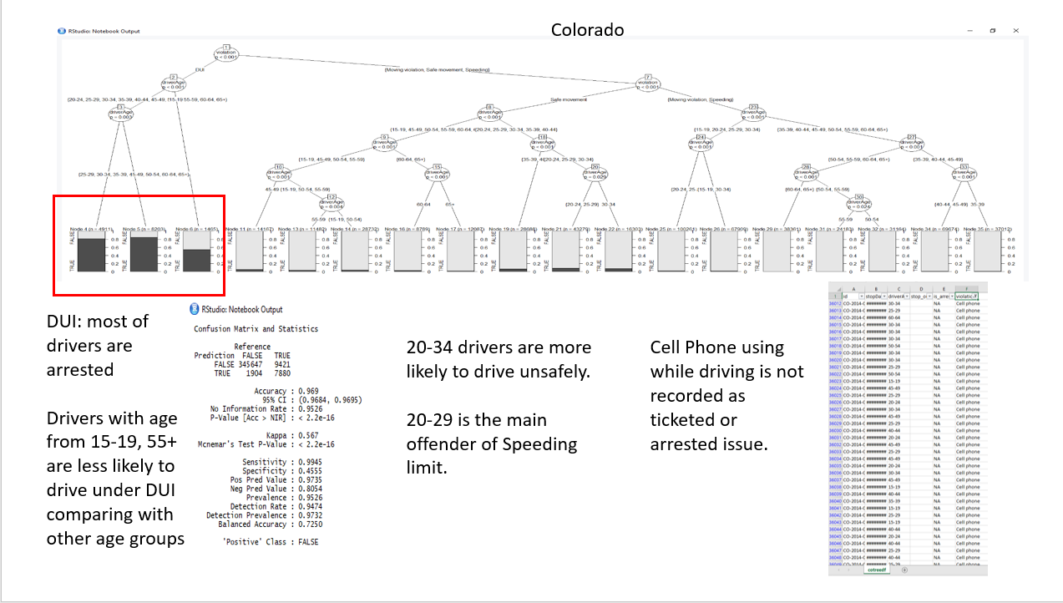
Colorado

Slide 13
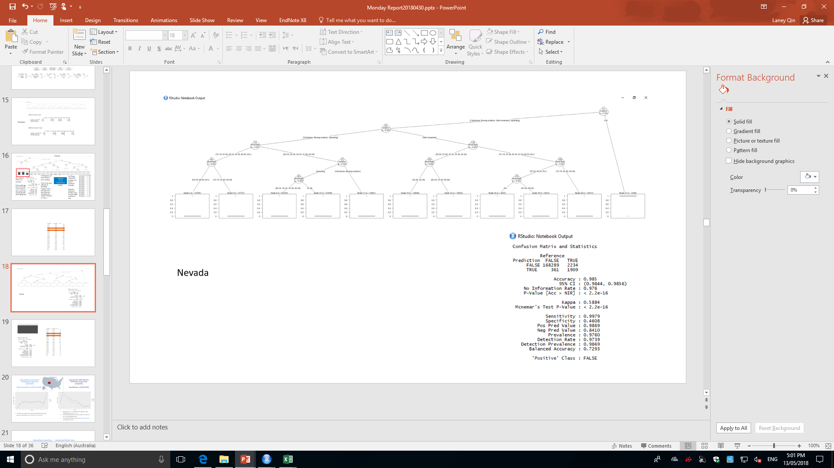
Nevada
Rule1: Driver with DUI would be put into the jail.

Slide 14
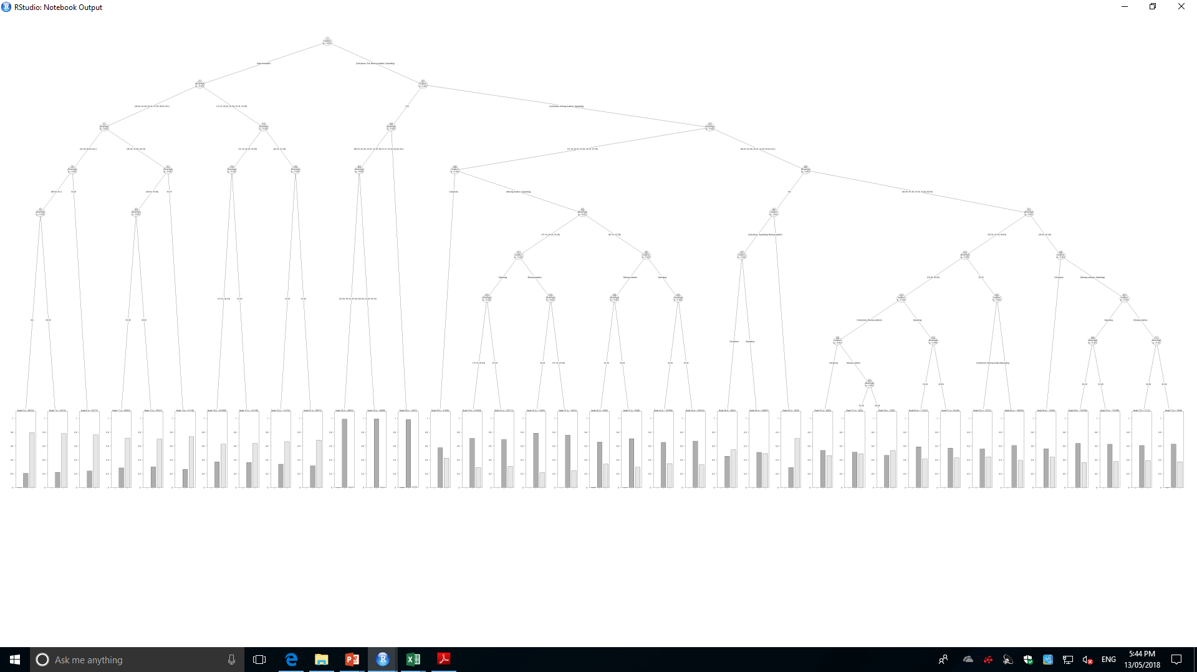
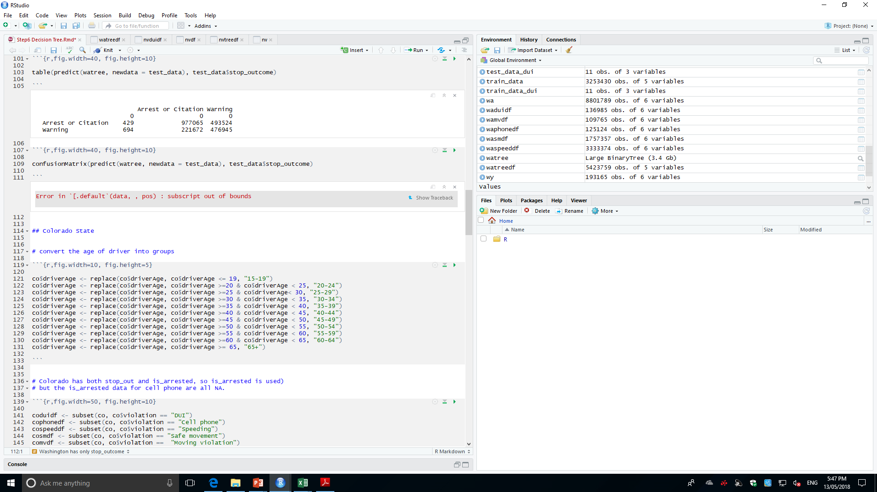
Washington
Hard to tell clearly about the rules

Slide 15
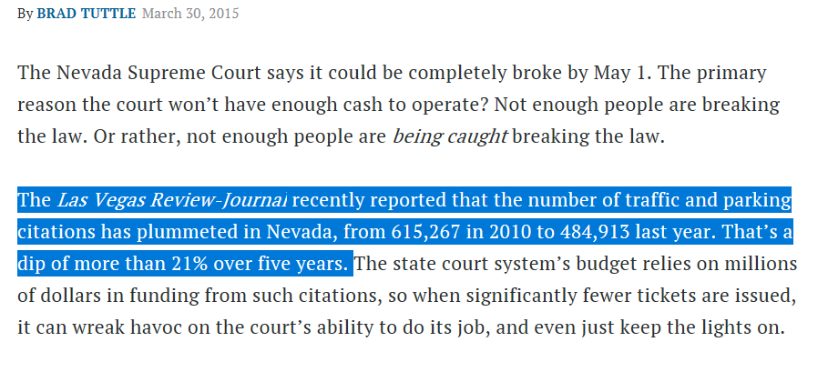
It increased greatly 69% in all types of violations from 2013 to 2014
NV | 2013 | 2014
Cell phone | 8135 | 16170
DUI | 162 | 1532
Equipment | 1704 | 2632
License | 10507 | 17162
Lights | 1343 | 1858
Moving violation | 1712 | 2186
Other | 1268 | 4764
Other (non-mapped) | 3991 | 6402
Paperwork | 24876 | 41301
Registration/plates | 2361 | 3523
Safe movement | 20855 | 30409
Seat belt | 5584 | 8995
Speeding | 55617 | 96539
Stop sign/light | 15 | 85
Total | 138130 | 233558
SO:
Incomplete data from Nevada Law Enforced Agencies supplied to Stanford Dataset
http://time.com/money/3762033/traffic-ticket-decrease-speed-limits-police/

Slide 16
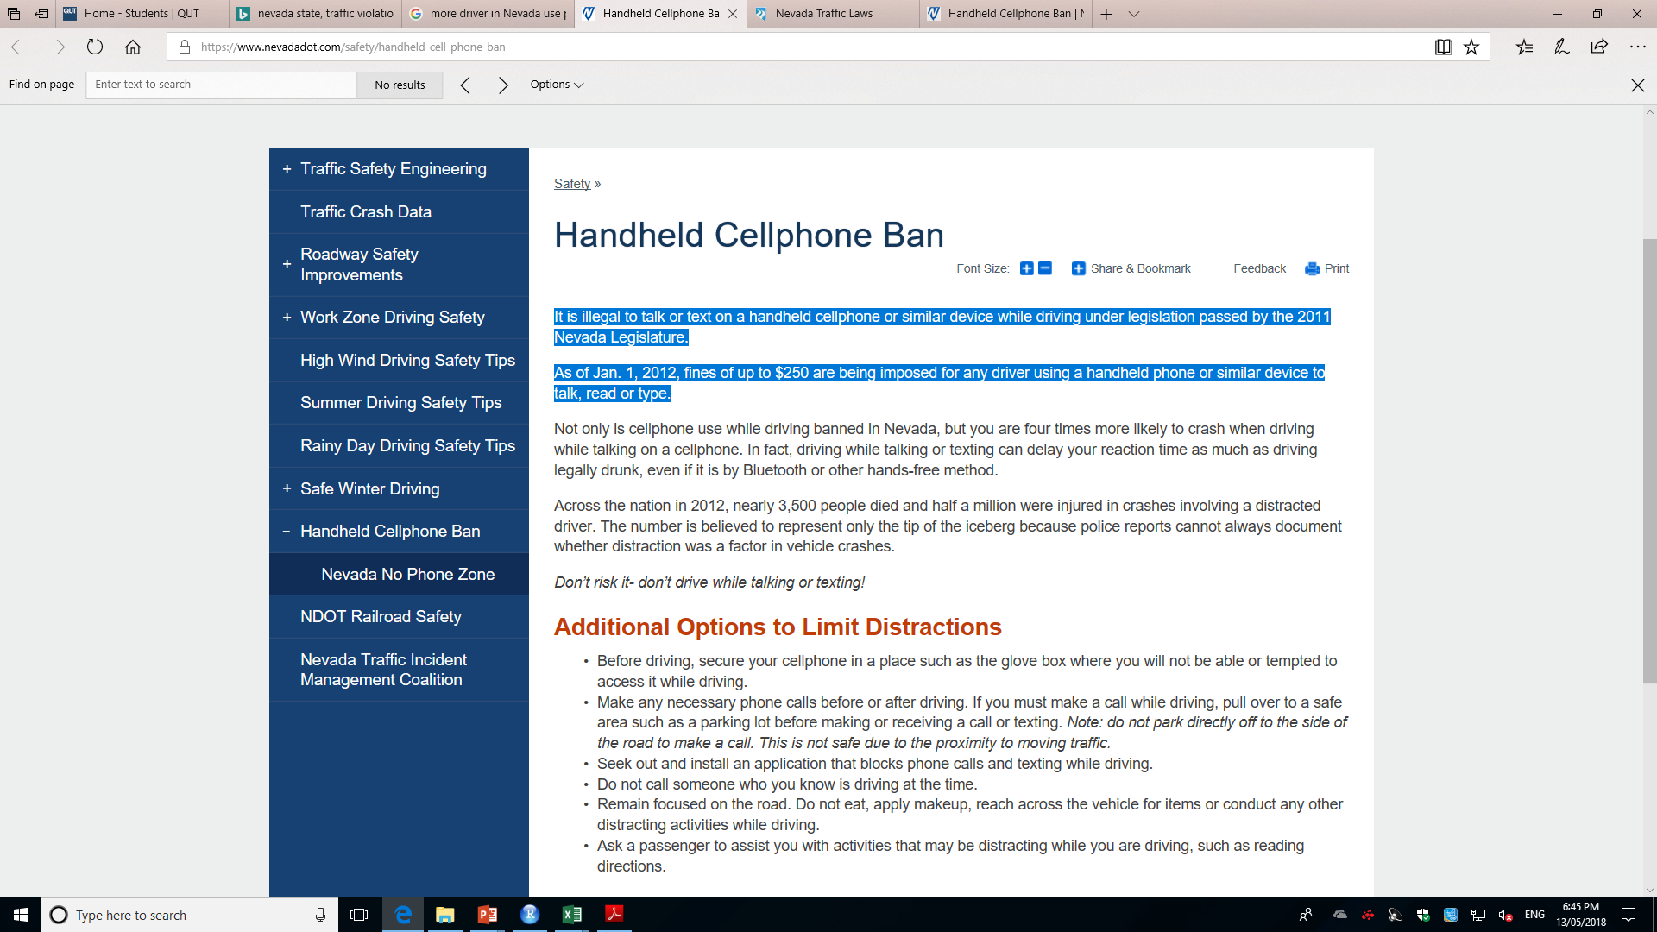
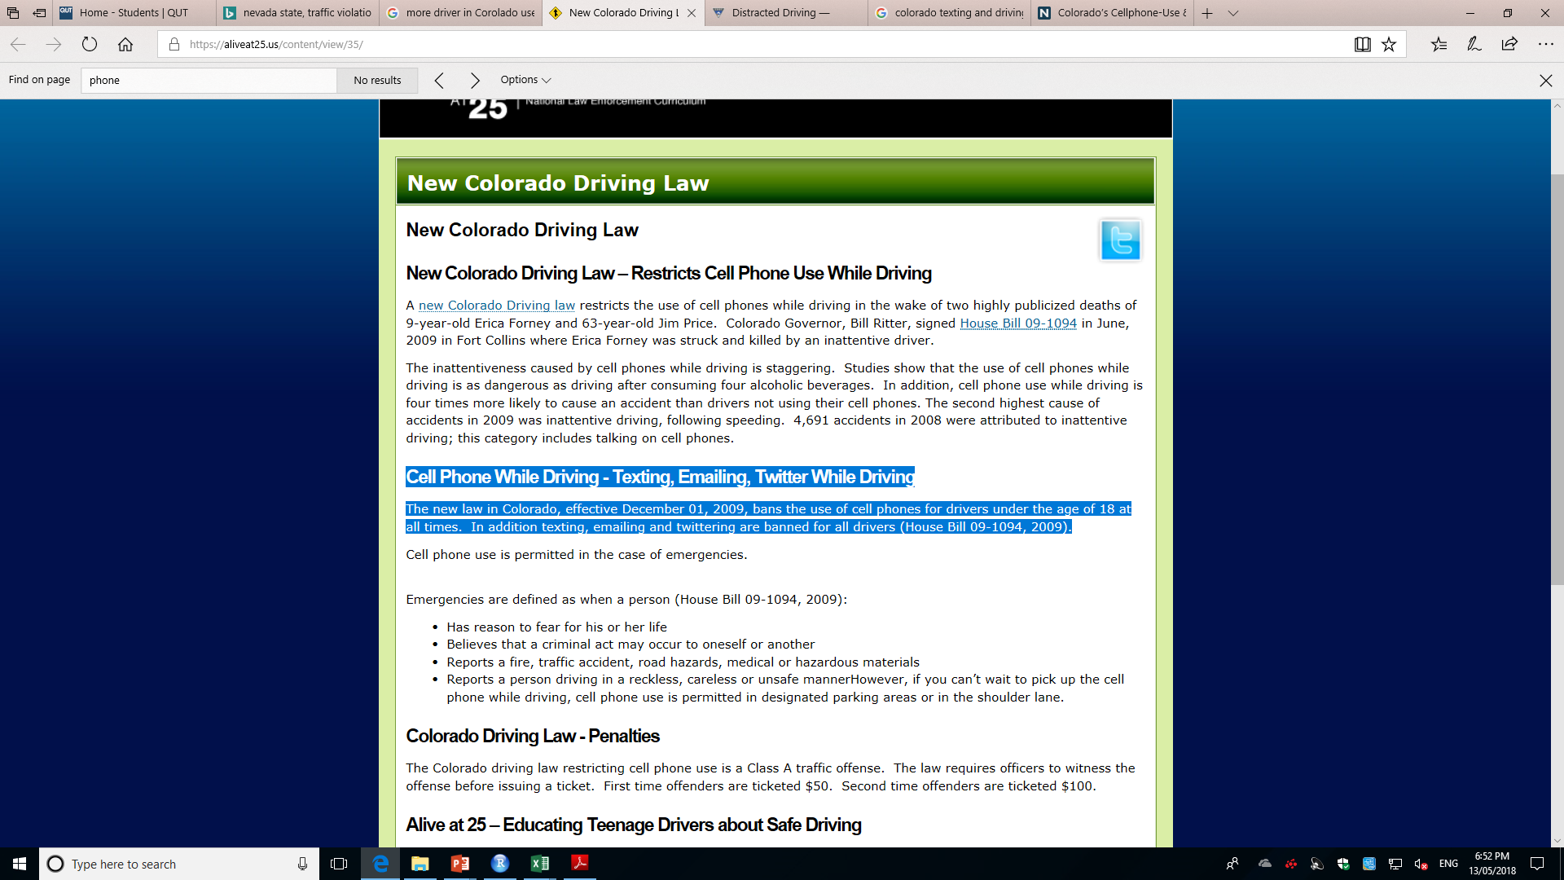
The percentage of the targeted violation based on the total violation, by State, by violation
State | Total Violation | Speeding | S ~ TV% | Safe movement | Sm ~ TV% | DUI | DUI ~ TV% | Cell Phone | CP ~ TV% | Moving violation | Mv ~ TV%
Washington | 8,624,032 | 3333374 | 38.65% | 1757357 | 20.38% | 136985 | 1.59% | 125124 | 1.45% | 109765 | 1.27%
Colorado | 2,584,744 | 968124 | 37.46% | 420260 | 16.26% | 36010 | 1.39% | 2447 | 0.09% | 3788 | 0.15%
Nevada | 737,294 | 288802 | 39.17% | 90138 | 12.23% | 5592 | 0.76% | 41457 | 5.62% | 7136 | 0.97%
North Dakota | 330,063 | 204733 | 62.03% | 11271 | 3.41% | 9821 | 2.98% | 429 | 0.13% | N/A | N/A
Wyoming | 173,455 | 121705 | 70.17% | 7494 | 4.32% | 2306 | 1.33% | 136 | 0.08% | 371 | 0.21%
SO:
Every state has strict law based on different violations. Hard to explain why Nevada has higher violation percentage in cell phone.
https://www.nevadadot.com/safety/handheld-cell-phone-ban

Slide 17
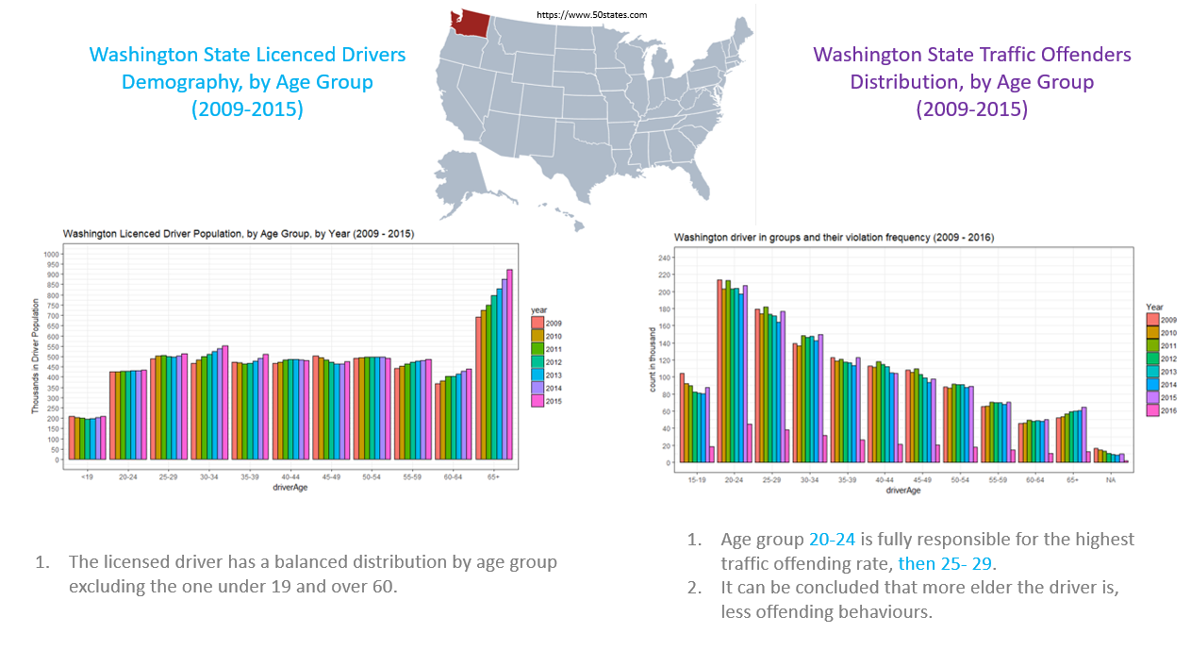

Slide 18
Significance of Outcomes
Motivation → Improving data collection, analysis and reporting by law enforcement agencies → Facilitating the policing policy maker and police practices in diverse communities → Contributing to the research, journalism and commentary related to the policing data
Anticipated Significance → Developing the driver guideline including safety tips for diverse groups → Improving the traffic warning signs → Encouraging the spread of IOT to supervise the driving error activities rather than patrolling and filling in various log data

Slide 19
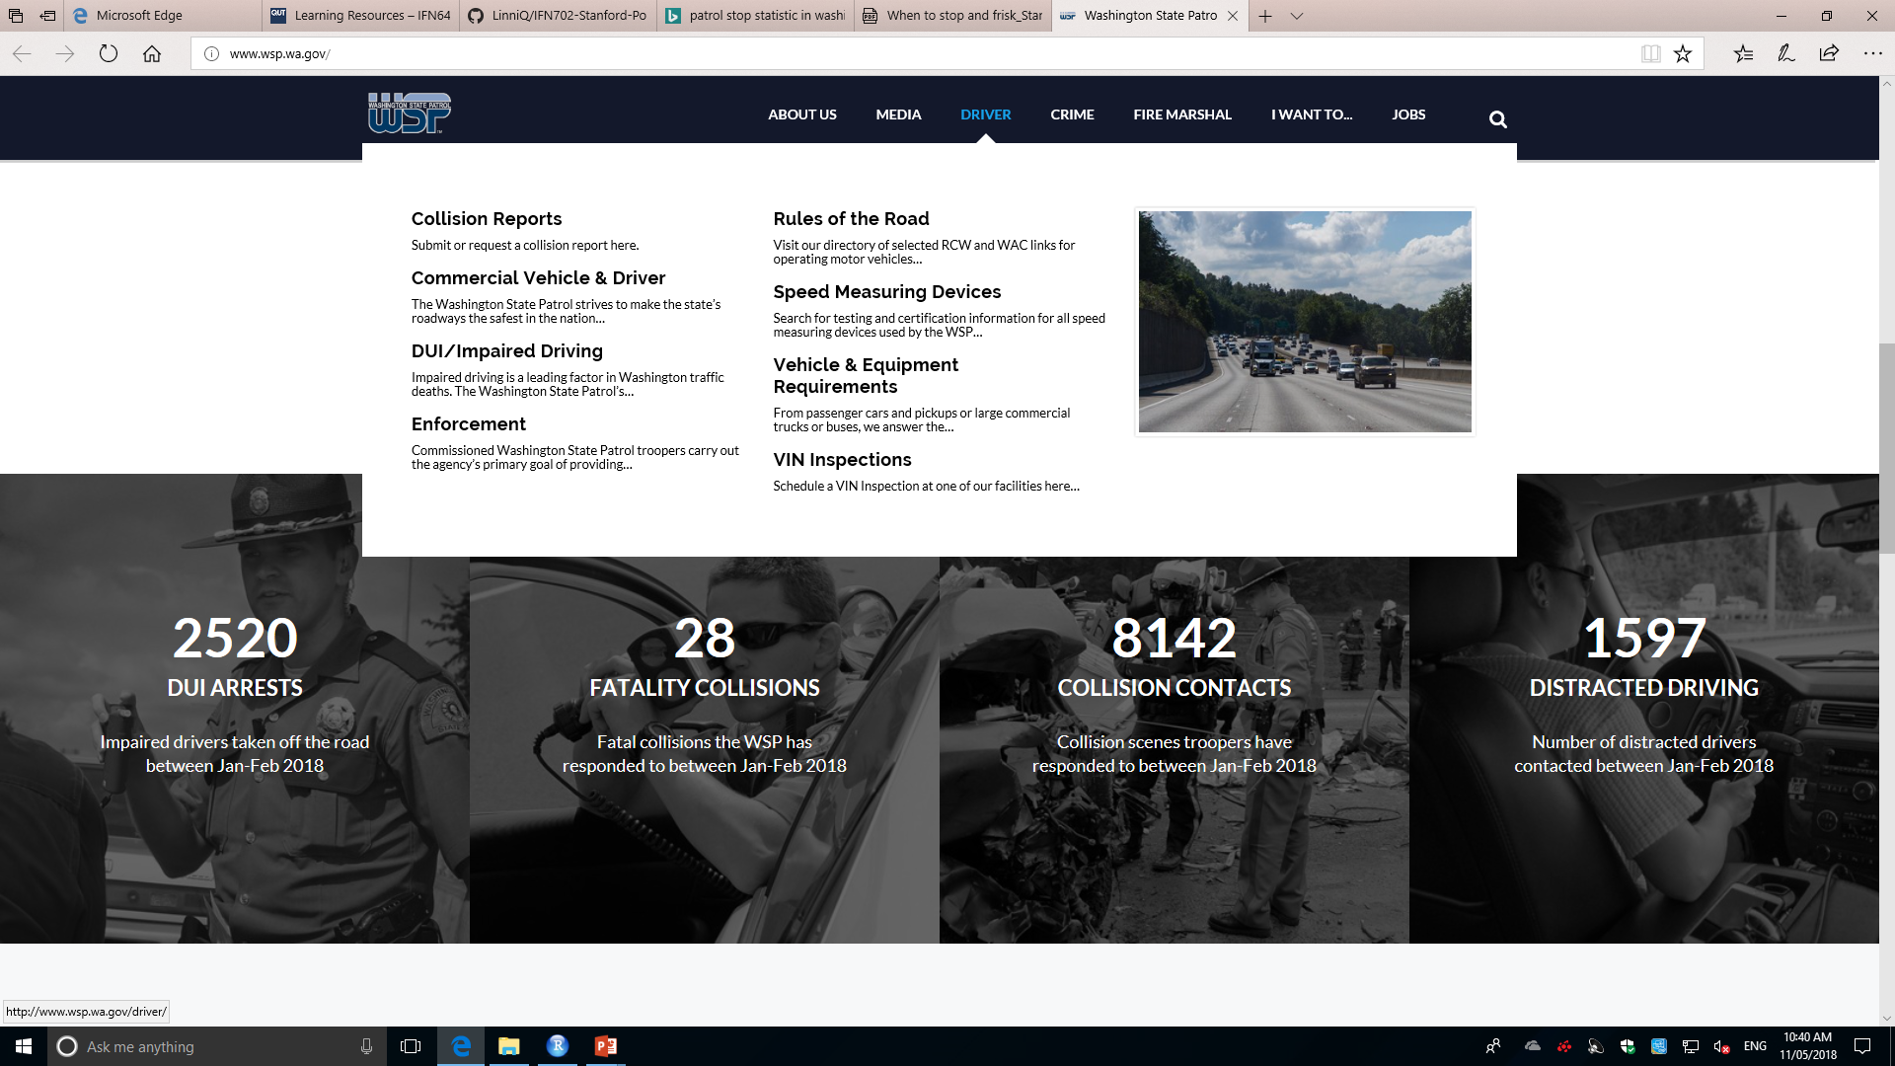
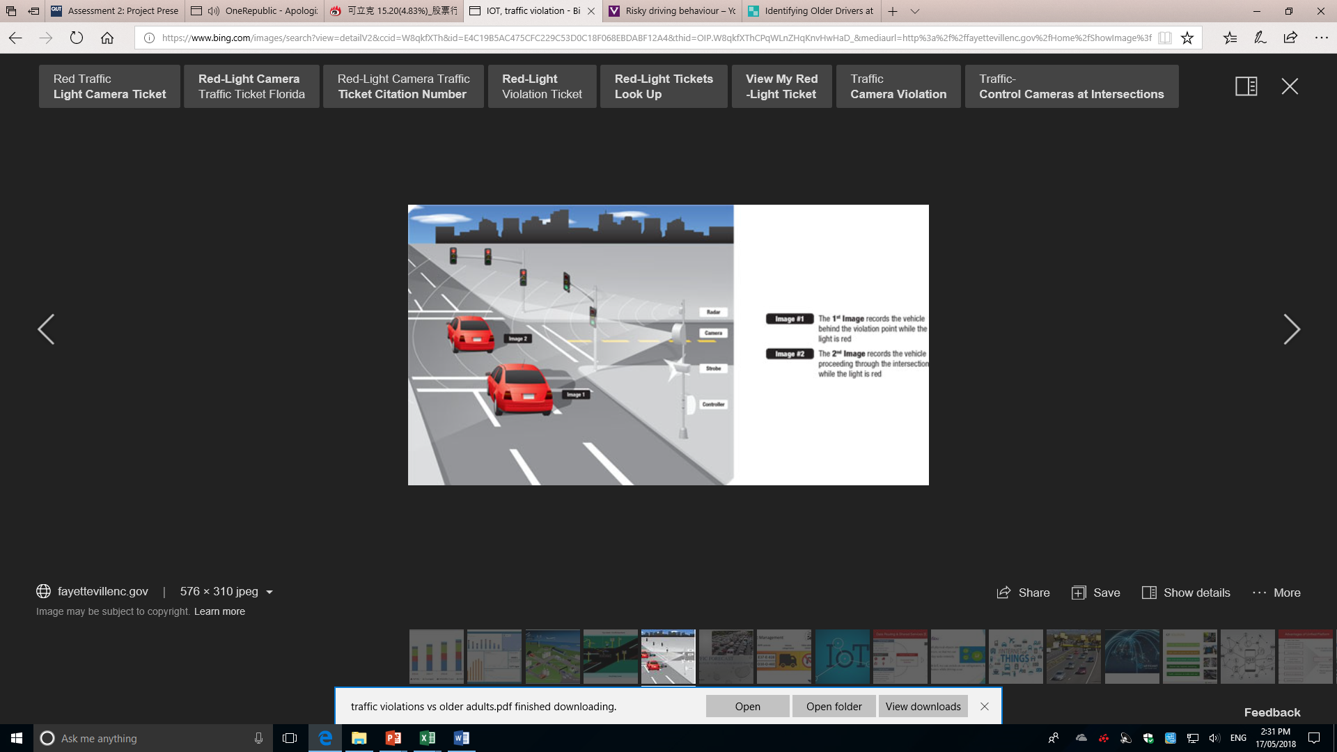
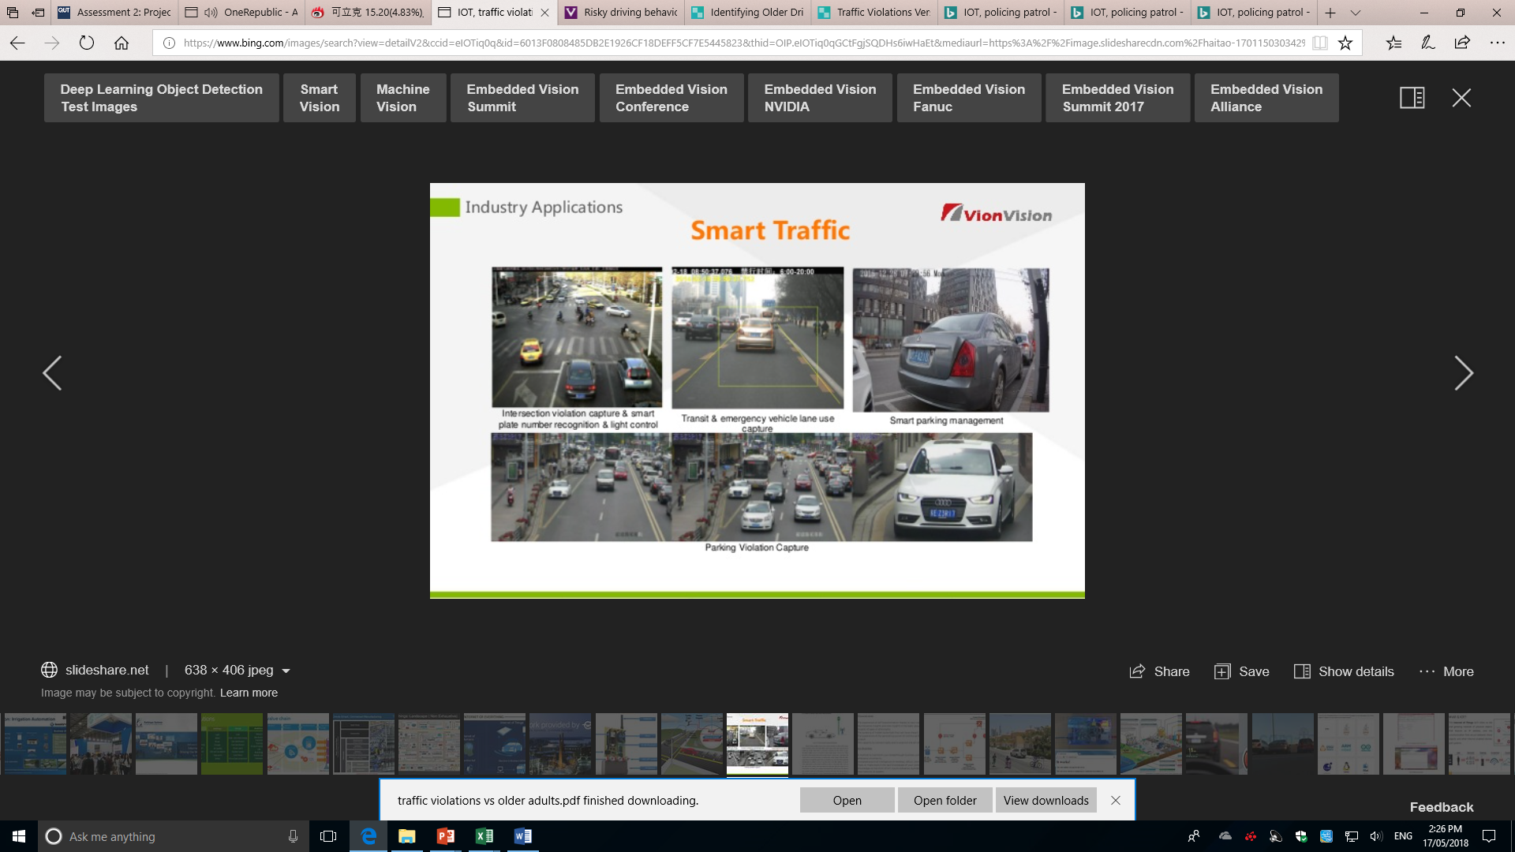
Significance of Outcome - Examples
Pictures from http://www.wsp.wa.gov/

Slide 20

The End

Slide 21
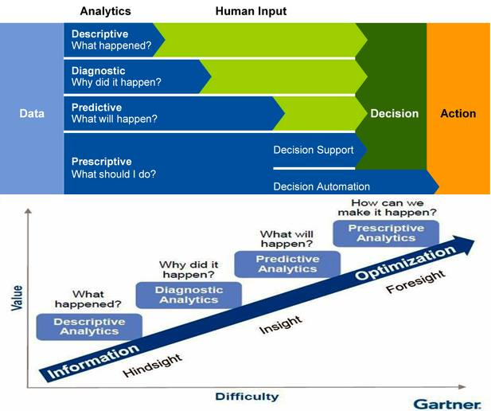
Project Purpose
Pictures from http://www.gartner.com/newsroom/id/2881218

Slide 22
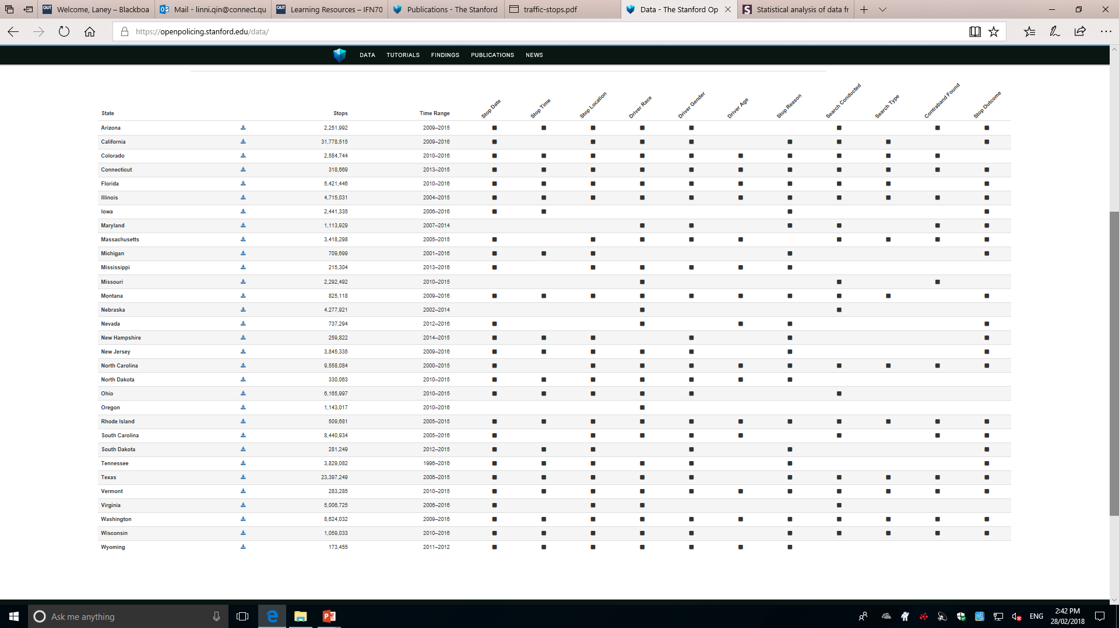
31 states
Standardized 11 attributes

Slide 23
Population, Motor vehicle crash deaths and Motor vehicle crash deaths rate, 2014, USA
State | Population | Crash Deaths | Deaths per 100,000 population
Washington | 7,061,530 | 462 | 6.5
Colorado | 5,355,966 | 488 | 9.1
Nevada | 2,839,099 | 290 | 10.2
North Dakota | 739,482 | 135 | 18.3
Wyoming | 584,153 | 150 | 25.7
http://www.iihs.org/iihs/topics/t/general-statistics/fatalityfacts/state-by-state-overview/2014

Slide 24
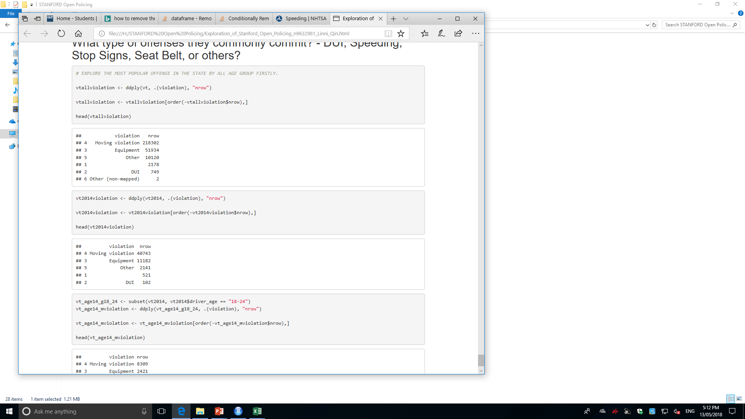
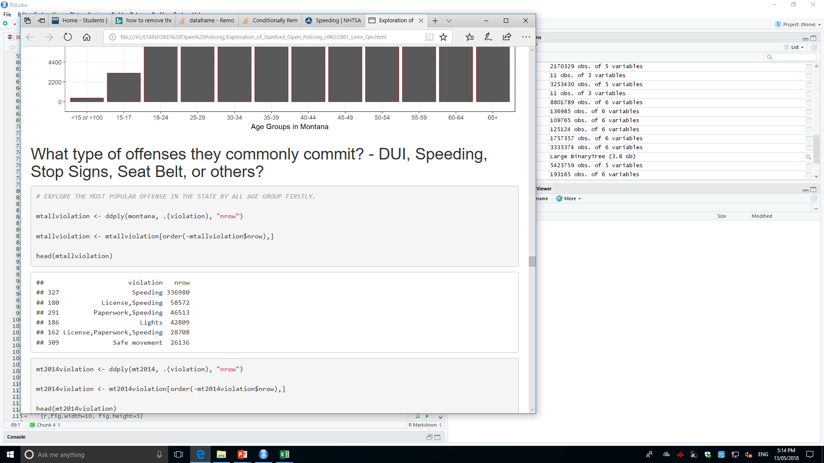
Project Problems
Top Causes of Car Accidents in the US
Top 1: Speeding
Top 2: DUI (driving under the influence of alcohol or drug)
Top 3: Distracted Driving (e.g. Cell Phone or other digital device use)
Top 4: Reckless Driving (Unsafe Movement) (eg. Failing to adhere the stop signs, unsafe changes of direction or lanes)
Problems:
1. Dataset: Apparent difference among Time Range, Data size, Features

Slide 25
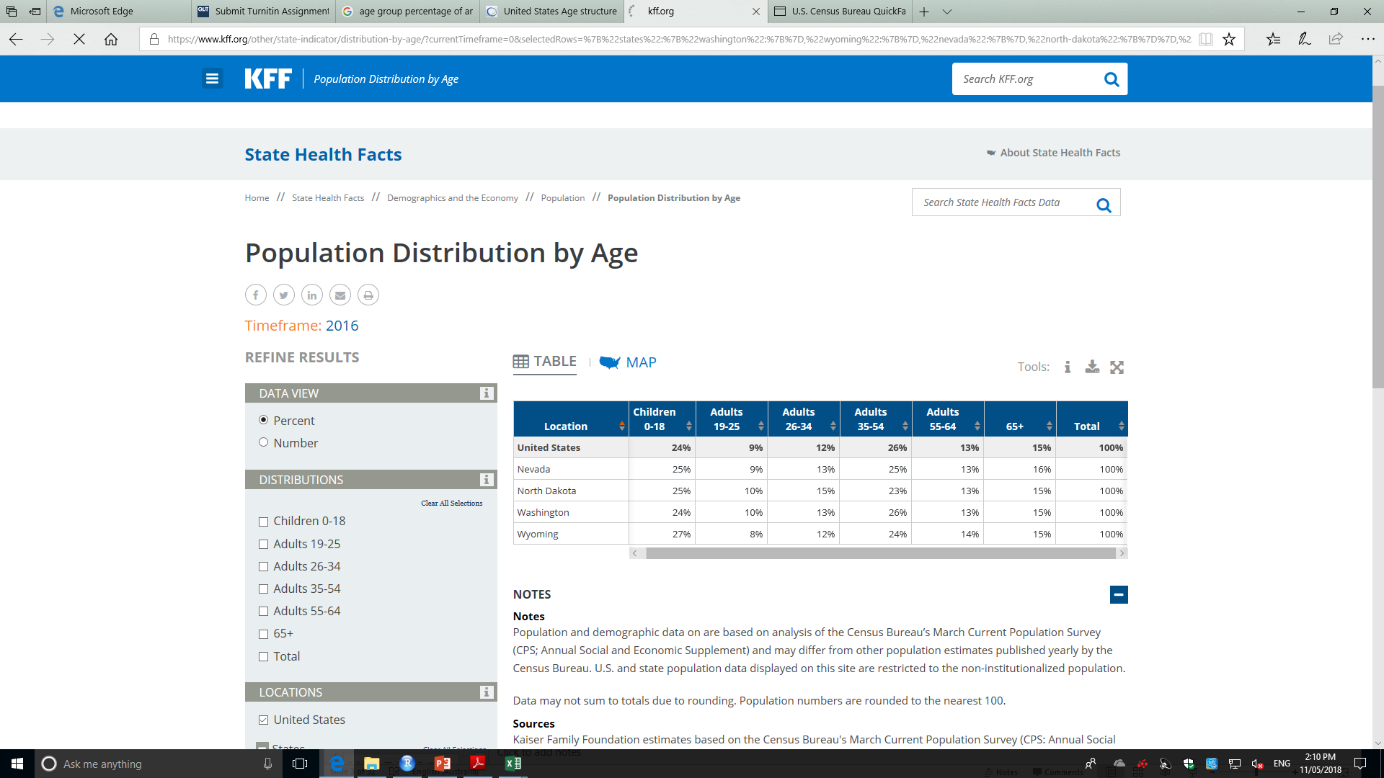
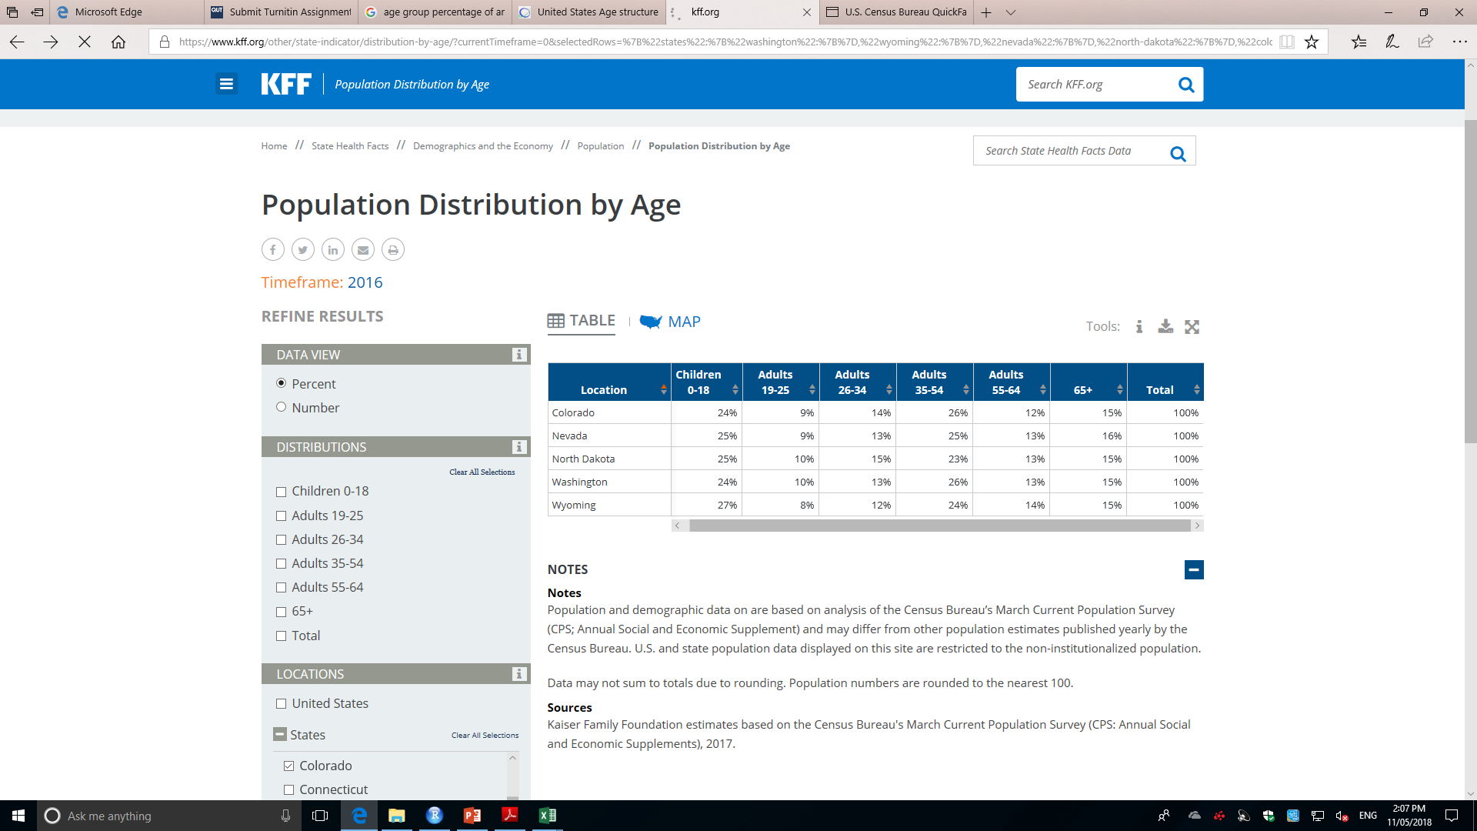
Outcomes Overview - Descriptive Analysis
Population Distribution by Age in USA 2016
Driver Number by Age in USA 2016
Age | Driver# | %
19 and Under | 9,743 | 5.11%
20-24 | 15,966 | 8.38%
25-29 | 17,585 | 9.22%
30-34 | 19,154 | 10.05%
35-39 | 21,060 | 11.05%
40-44 | 21,093 | 11.07%
45-49 | 19,153 | 10.05%
50-54 | 16,868 | 8.85%
55-59 | 12,760 | 6.69%
60-64 | 9,914 | 5.20%
65-69 | 8,386 | 4.40%
70-74 | 7,468 | 3.92%
75-79 | 5,911 | 3.10%
80-84 | 3,511 | 1.84%
85 and Over | 2,050 | 1.08%
Total | 190,625

Slide 26
Outcomes Overview
Stanford University (Dataset: Washington, 0.8 training, 0.1 validation, 0.1 test data): Model: Logistic Regression.
is_ticketed ~ driver_gender, driver_age, driver_race, violation, search_conducted, contraband_found, office_gender, office_race, lat, lon
Result: Black and Hispanic drivers are searched more often than whites
Laney (Datasets: Washington, Colorado, Nevada, each 0.5 train, 0.5 test): Model: Decision Tree
is_arrested ~ driver_age (age groups), violation
Result: DUI (near 86% drivers are arrested) Most of them are aged 20-30

Slide 27
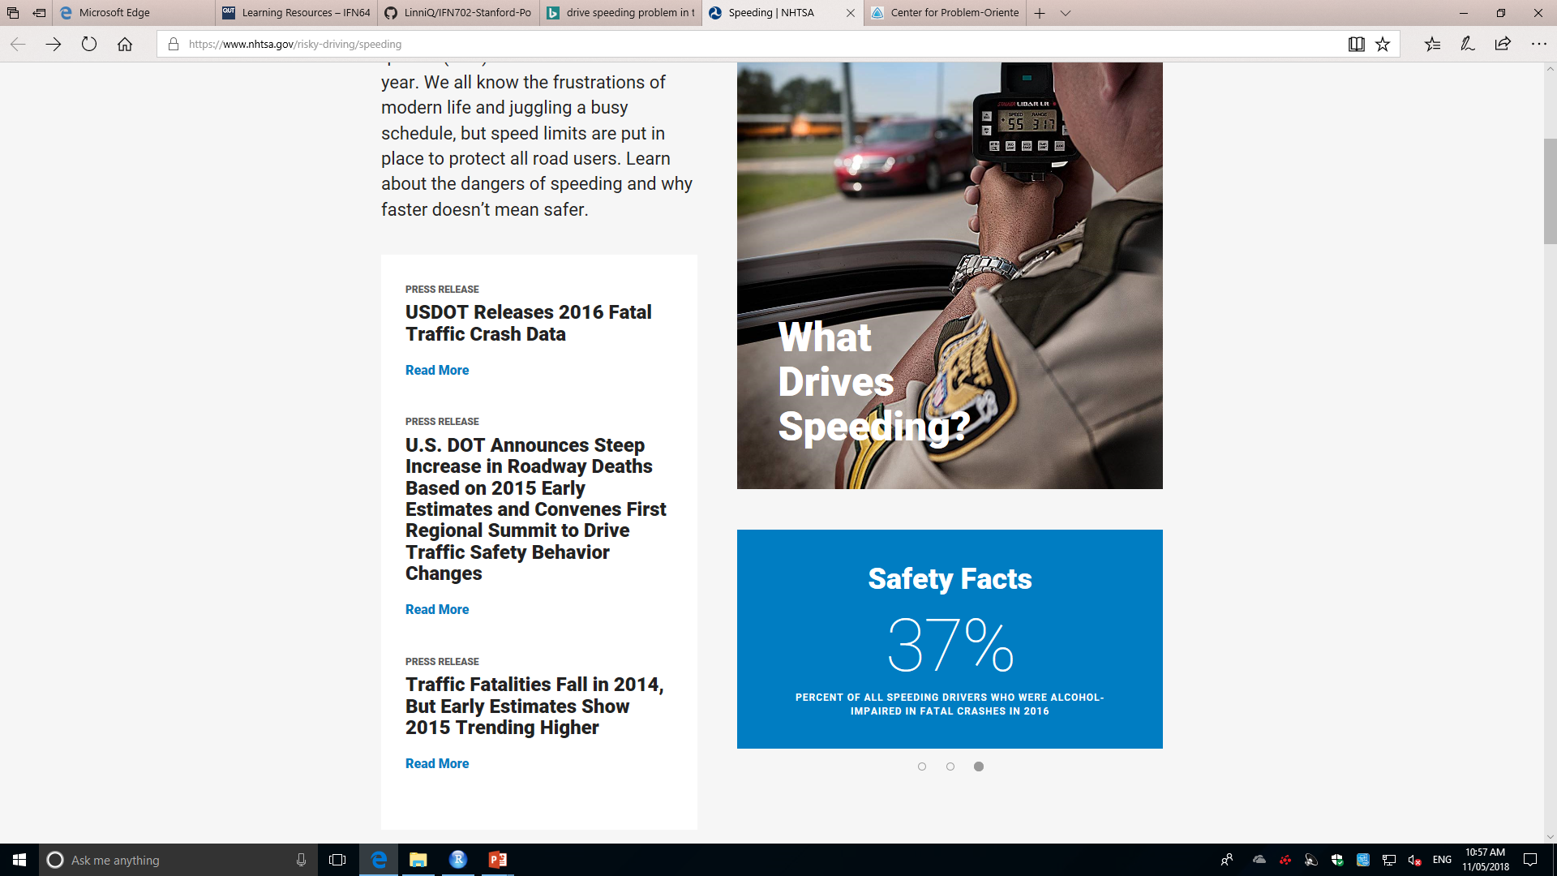
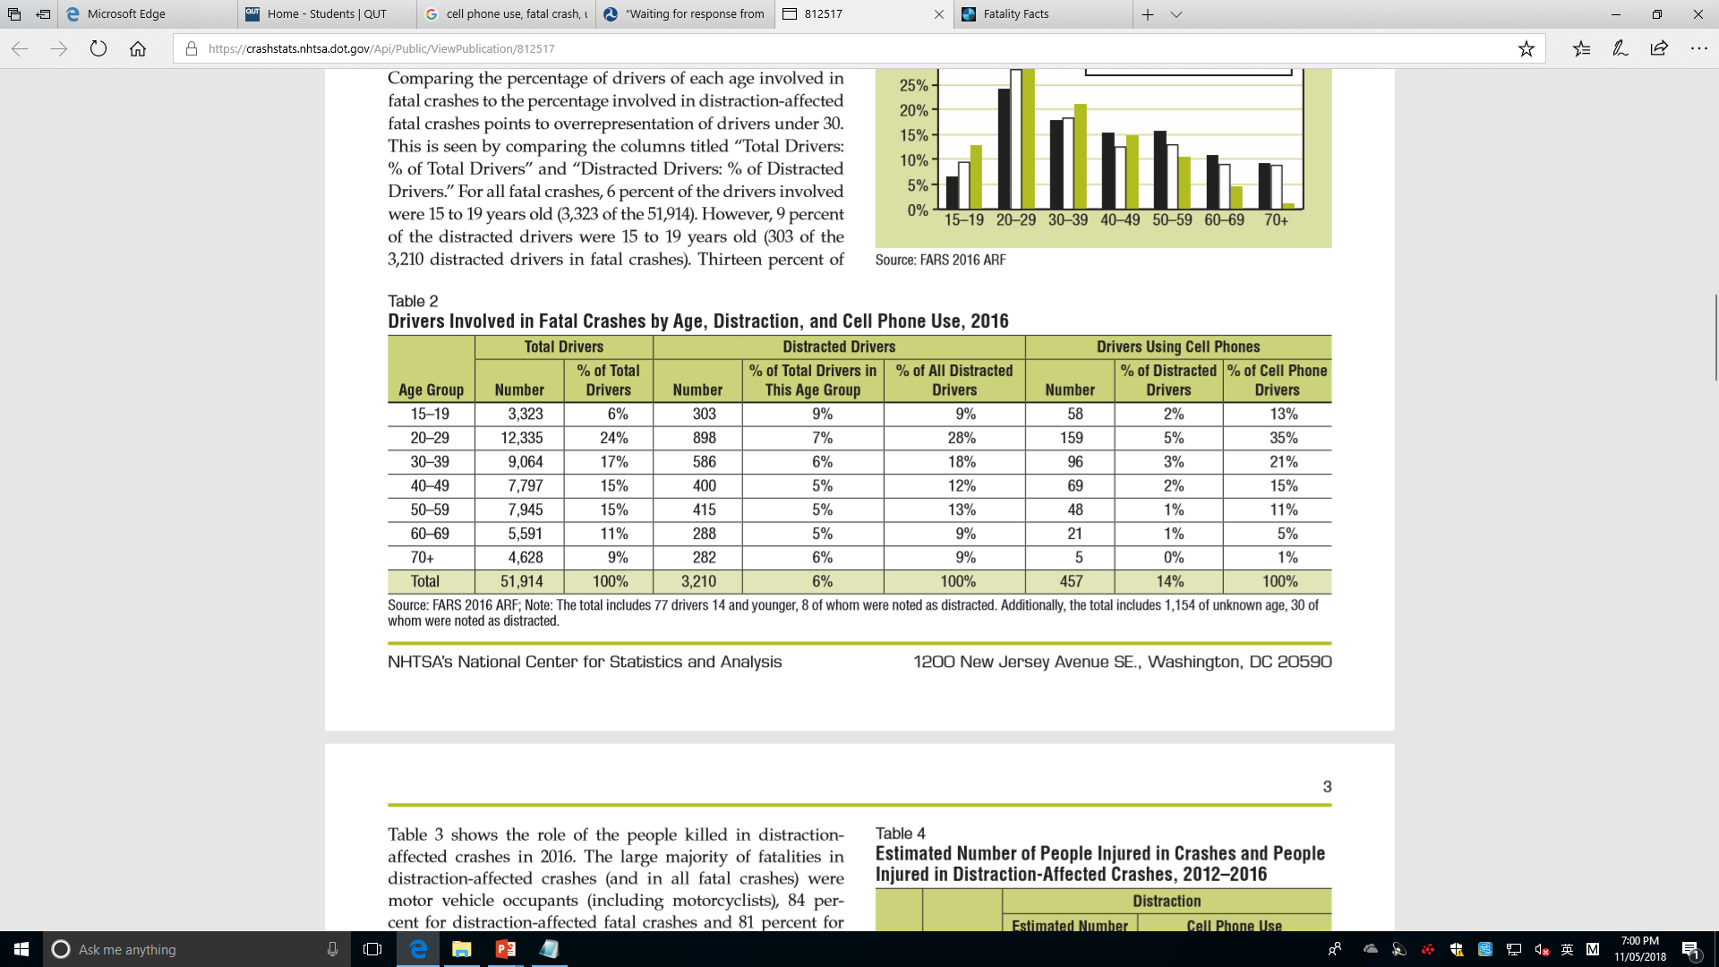
Project Background
https://crashstats.nhtsa.dot.gov/Api/Public/ViewPublication/812517
Pictures from https://www.nhtsa.gov/risky-driving/speeding/

